Slide 1
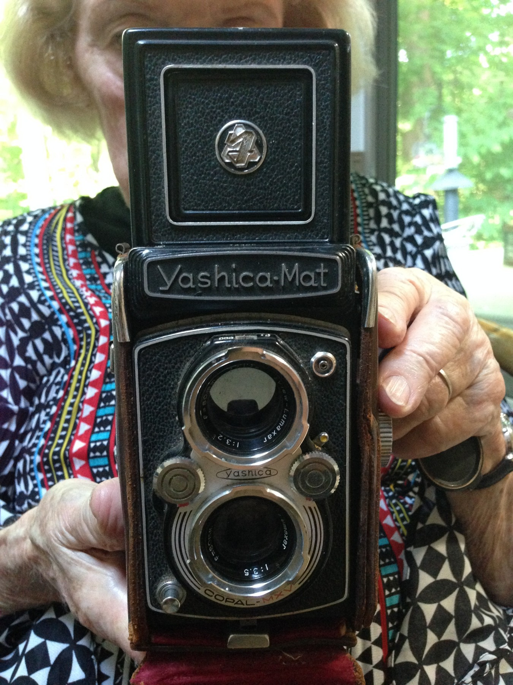
Mom, in pictures
Phillip Restle
Flying dangerously close to the sun

Slide 2
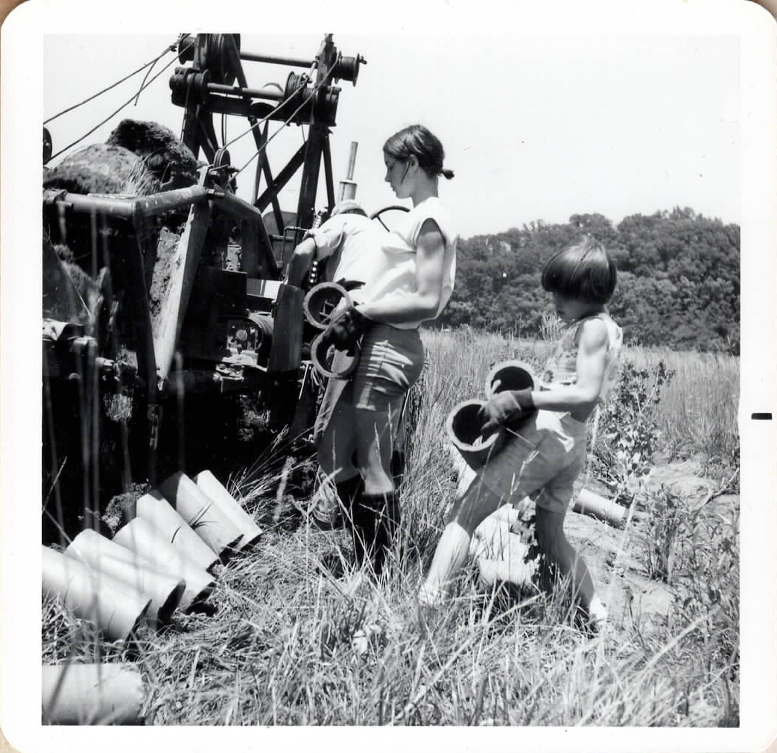
PART 1
Life on the farm
Draining the Bottom Road swamp for cornland, and growing up as the farm’s hired hands.

Slide 3
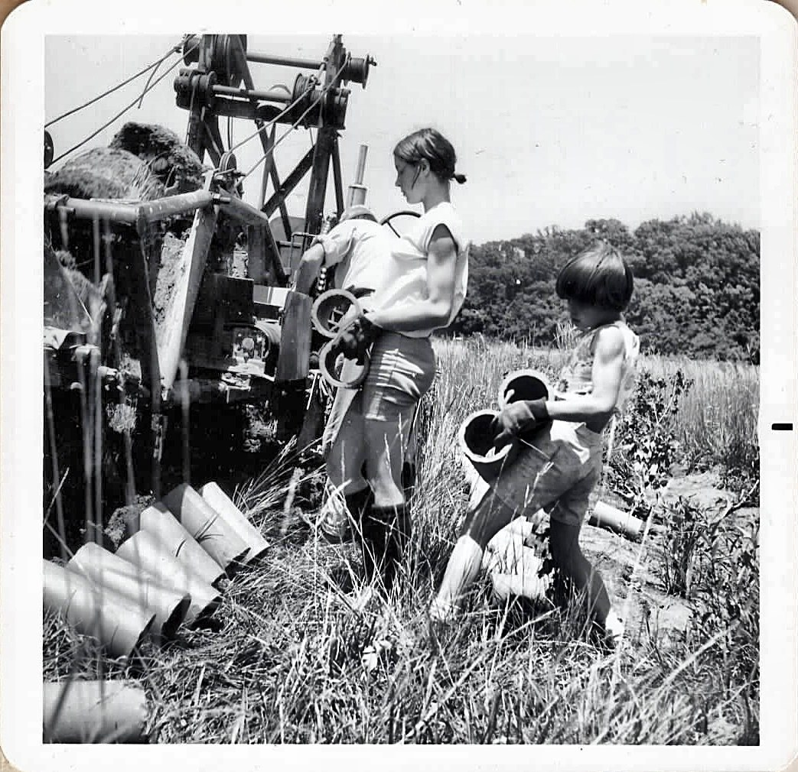
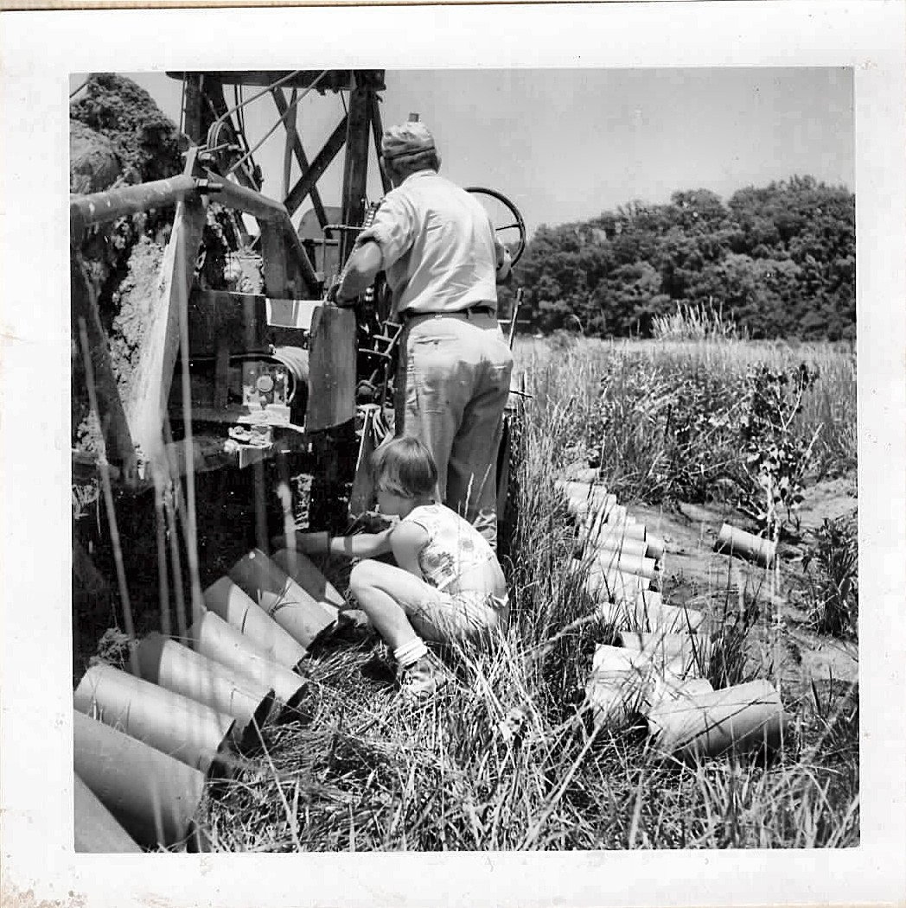
Laying the clay tile, c. 1965–1970
The children helped lay clay drainage tile behind the tile-laying machine to turn the Bottom Road swamp into cornland.

Slide 4
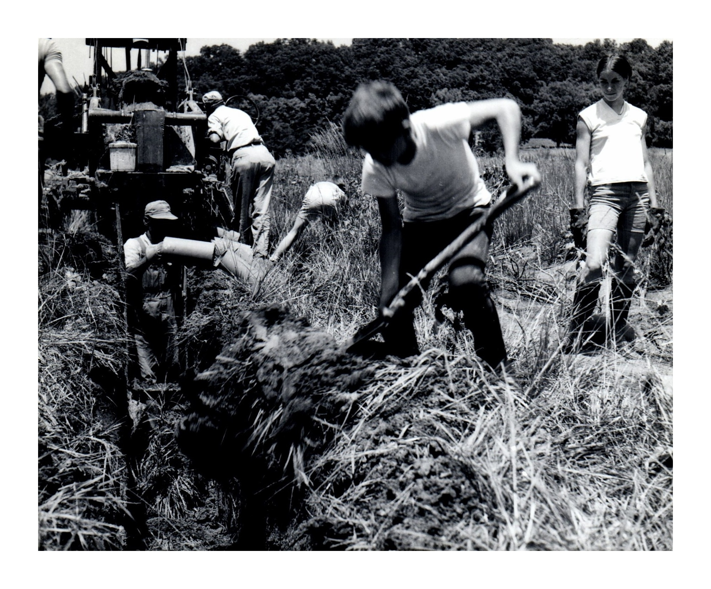
Digging the drainage trench, c. 1965–1970
Draining the Bottom Road swamp for cornland, laying clay tile behind the machine. Decades later Mom had the tile torn out, restored the wetland and gave the land away.

Slide 5
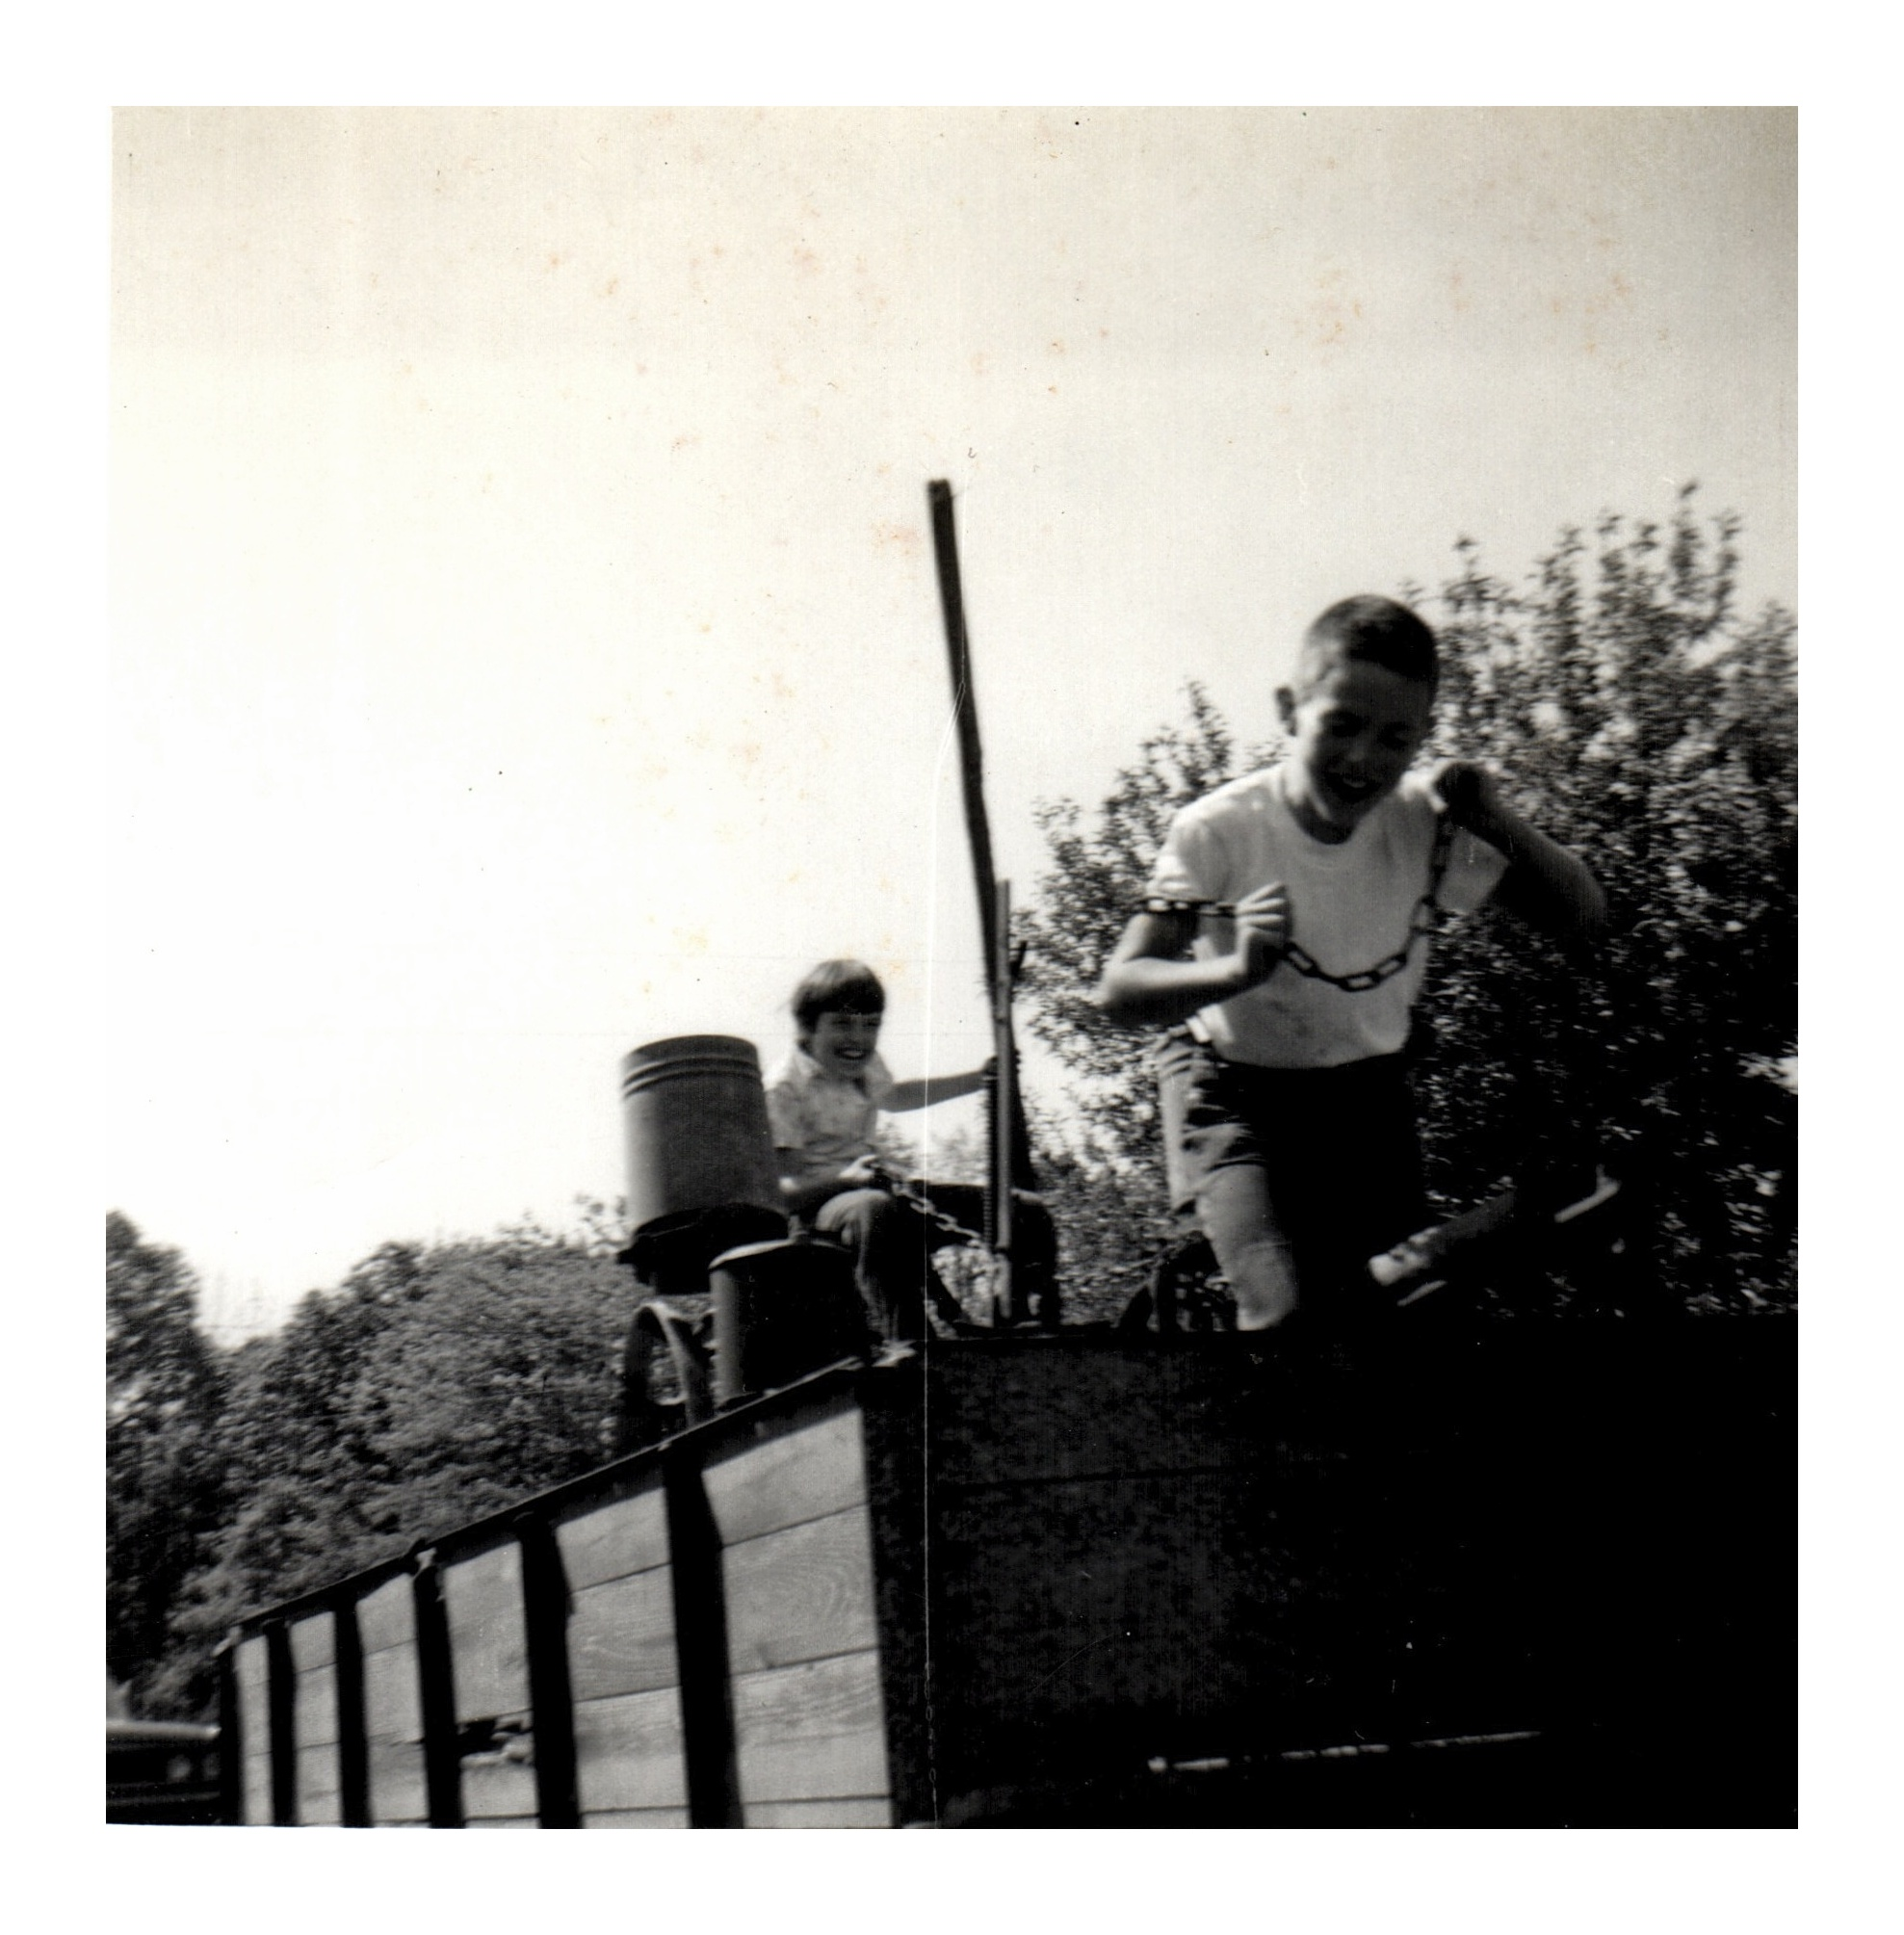
The chain gang, 1964

Slide 6
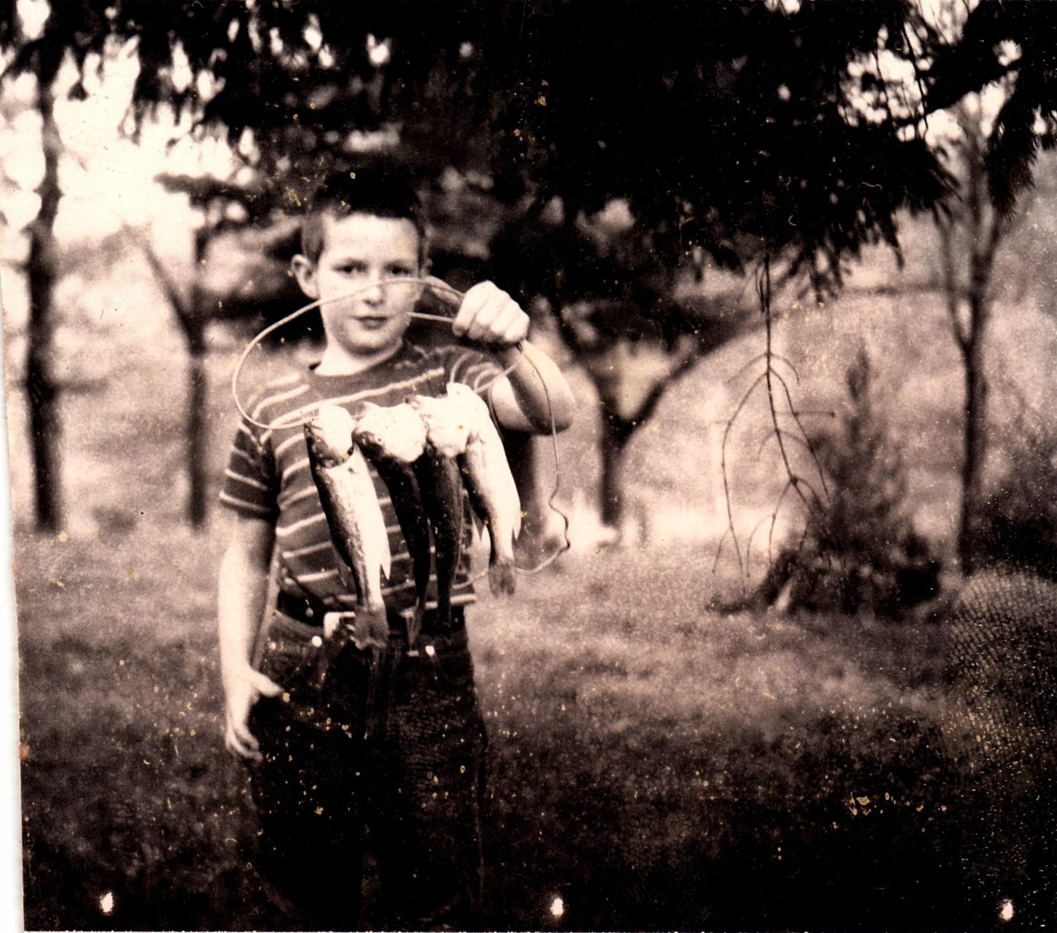
Phillip's catch, c. early 1970s
On the Restle farm, if you wanted dinner, you caught it yourself.

Slide 7
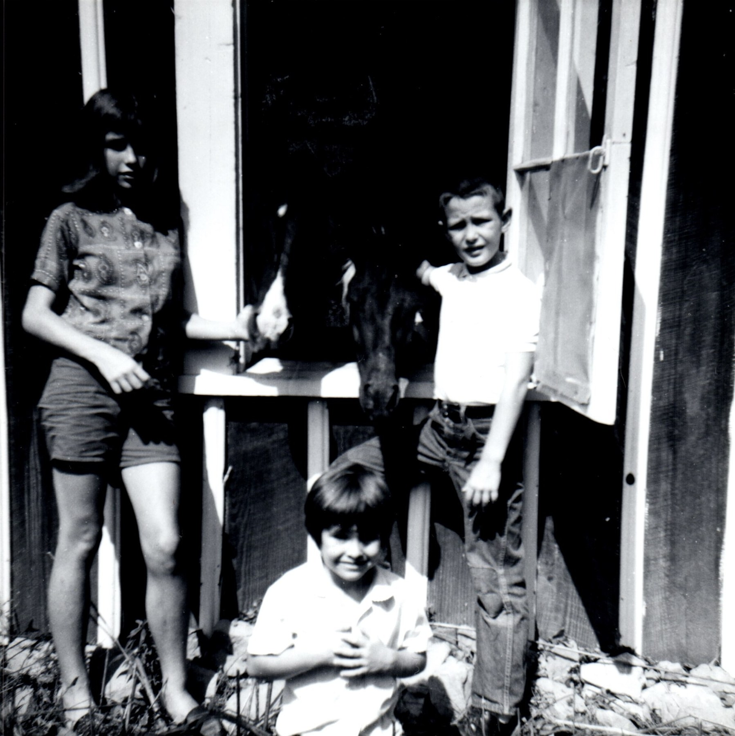
Sometimes we were allowed in the house
Princess, a Welsh Mountain pony who kicked each of us at least once, and her foal.

Slide 8
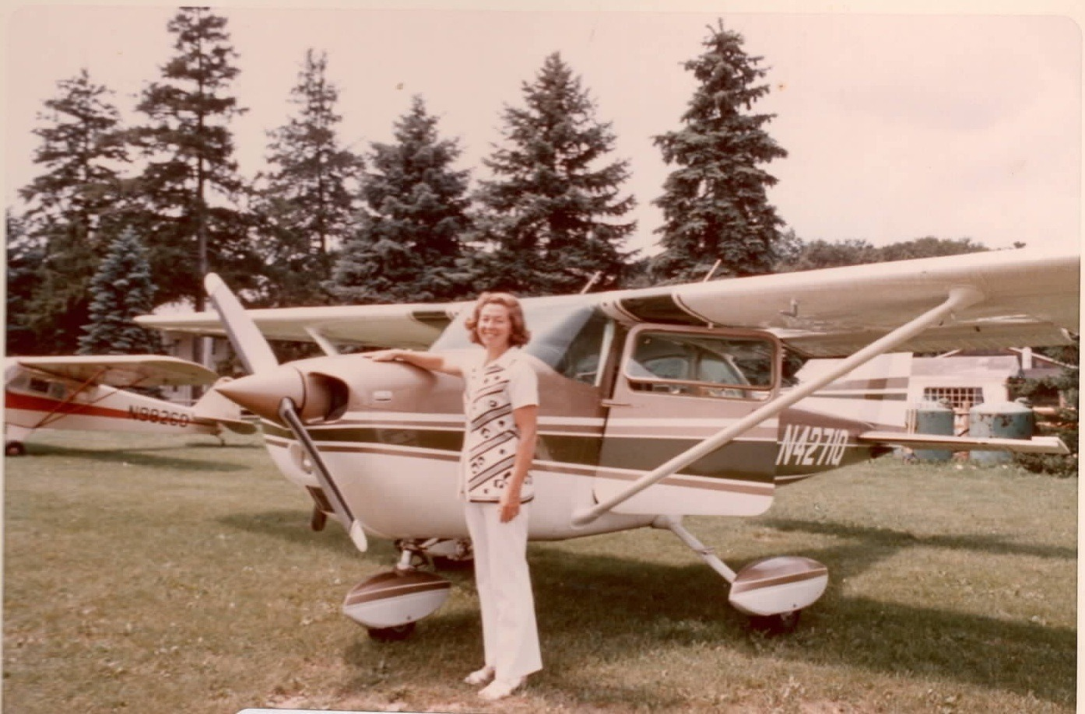
PART 2
Born to fly
A pilot’s license in the 1960s, and one more flight over the refuge at 90.

Slide 9
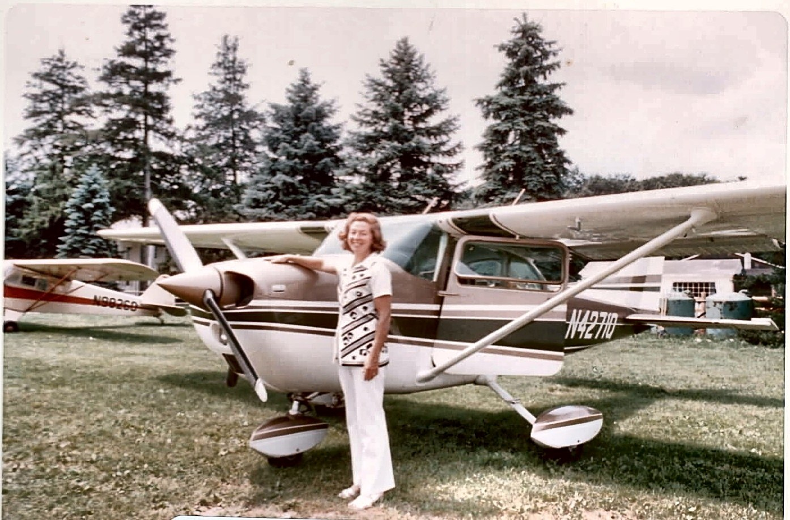
"Now Can I Fly Your Cessna, Dick!"
Barbara with her brother Dick's Cessna, c. 1966, around the time she earned her pilot's license.

Slide 10
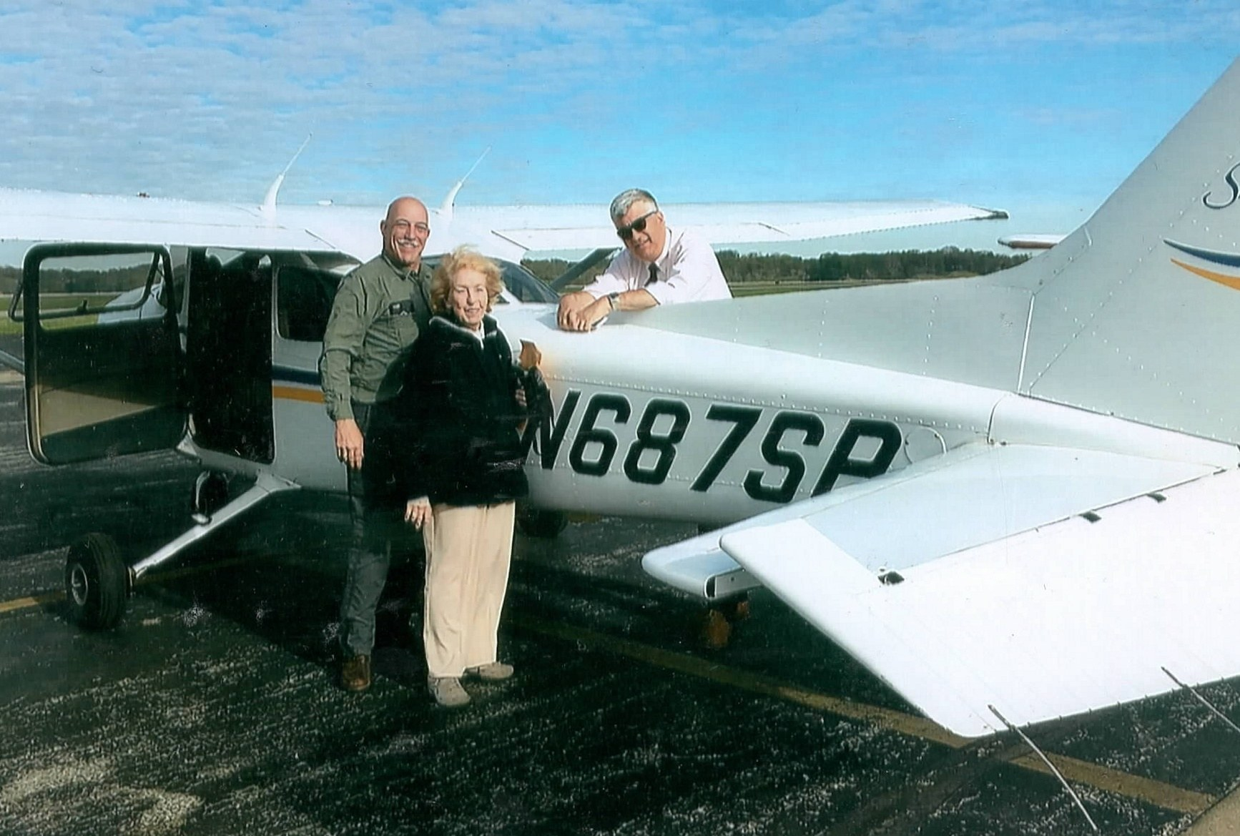
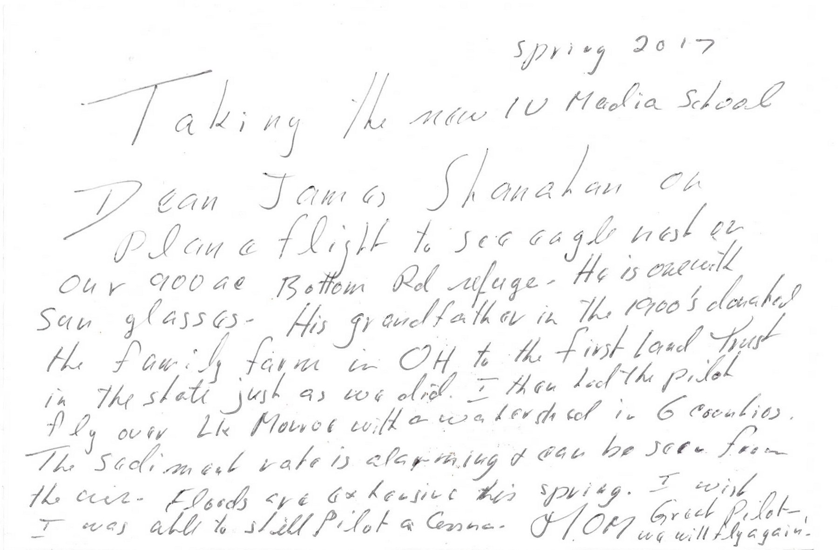
Flying over the refuge at 90, spring 2017
The only photo of Mom with her plane. On the back she wrote: "I wish I was able to still pilot a Cessna. Great Pilot - we will fly again!"

Slide 11
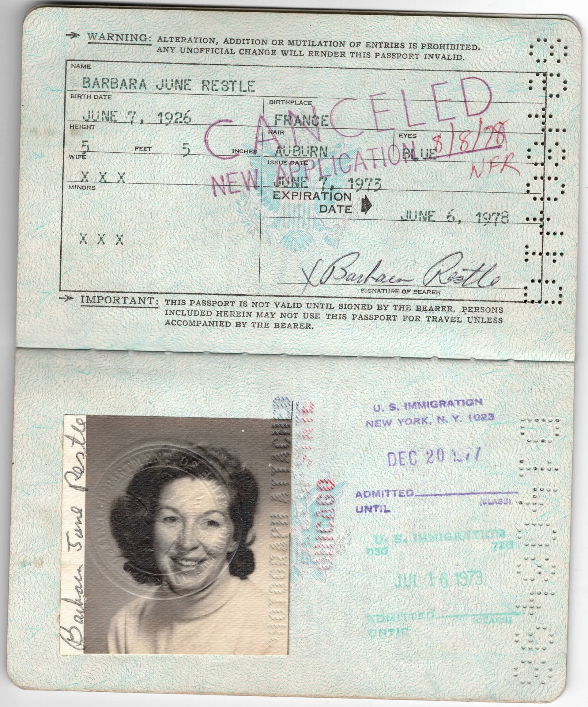
PART 3
Her passports
Three passports, 1973 to 2007

Slide 12

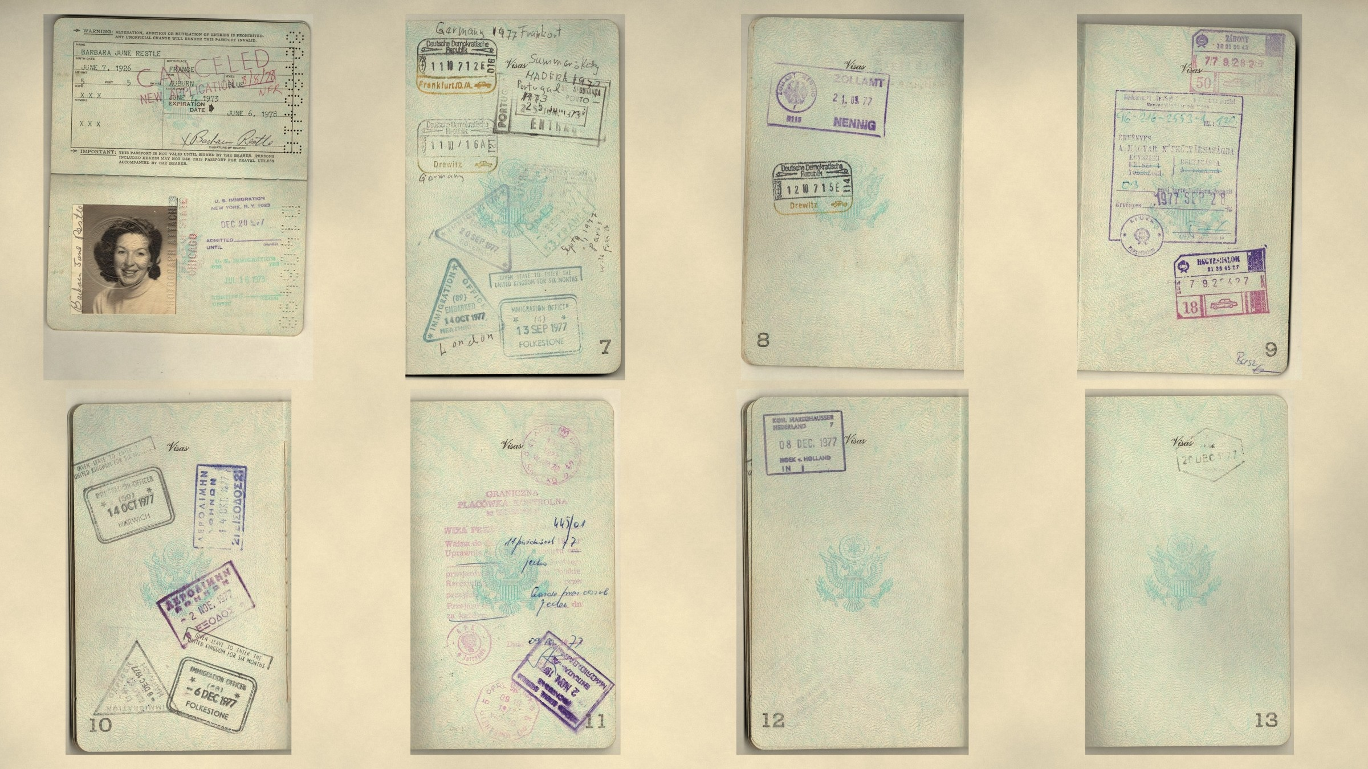
Her first passport, 1973–1978
Her first passport, issued on her 47th birthday in 1973. Its stamps trace a summer in Portugal and Madeira with Kathleen, then, after her 1977 degree, three months across Europe and behind the Iron Curtain: Paris, England, Hungary, the Soviet border, Poland, East Germany and Berlin, Athens and Madrid, home at Christmas.

Slide 13
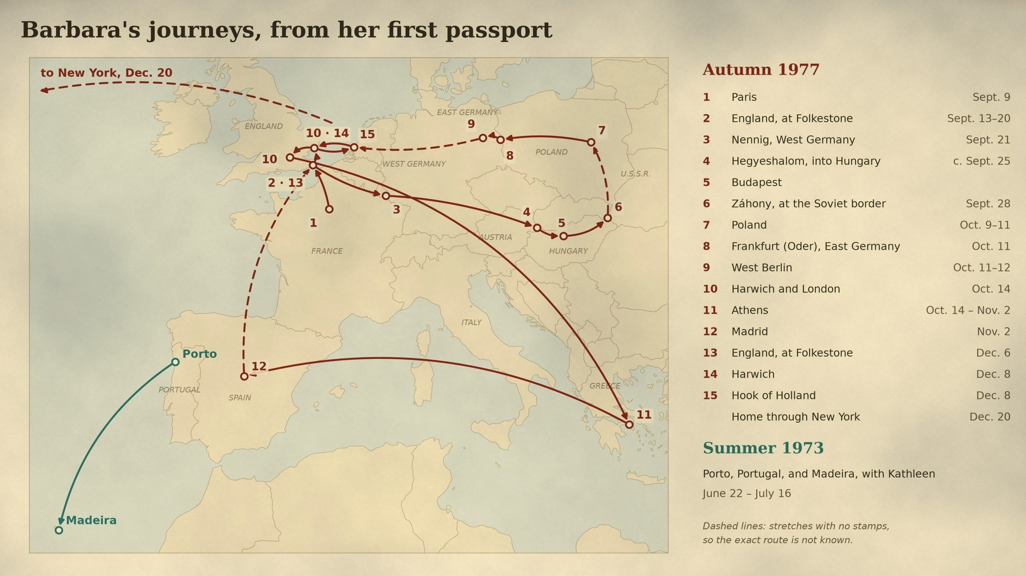
Map: her first passport journeys, 1973 and 1977
Where the passport stamps take her: Portugal and Madeira with Kathleen in 1973, and in autumn 1977 a loop from Paris and England through West Germany, Hungary and the Soviet border, Poland, East Germany and Berlin, then Athens, Madrid, England and Holland before flying home through New York.

Slide 14
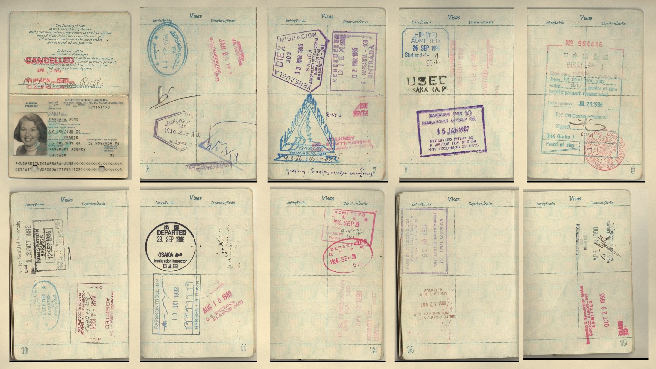
Her second passport, 1984–1995
Her second passport, issued in 1984. Over the next decade its stamps take her to Egypt, Venezuela, Bonaire, Hong Kong, Korea and Japan, Barbados, the Bahamas, Switzerland, France and Austria, and Norway.

Slide 15
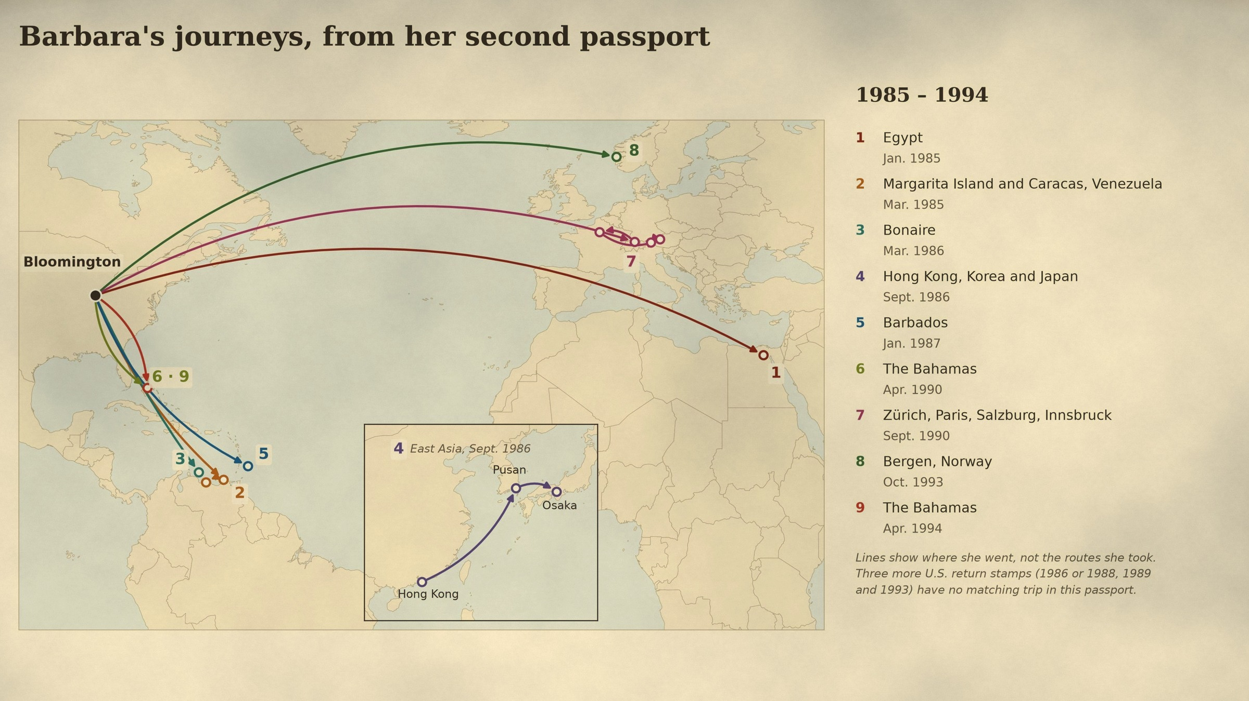
Map: her second passport journeys, 1985–1994
Where the second passport took her: the Pyramids, the Caribbean, East Asia and Europe, each trip starting from home in Bloomington.

Slide 16
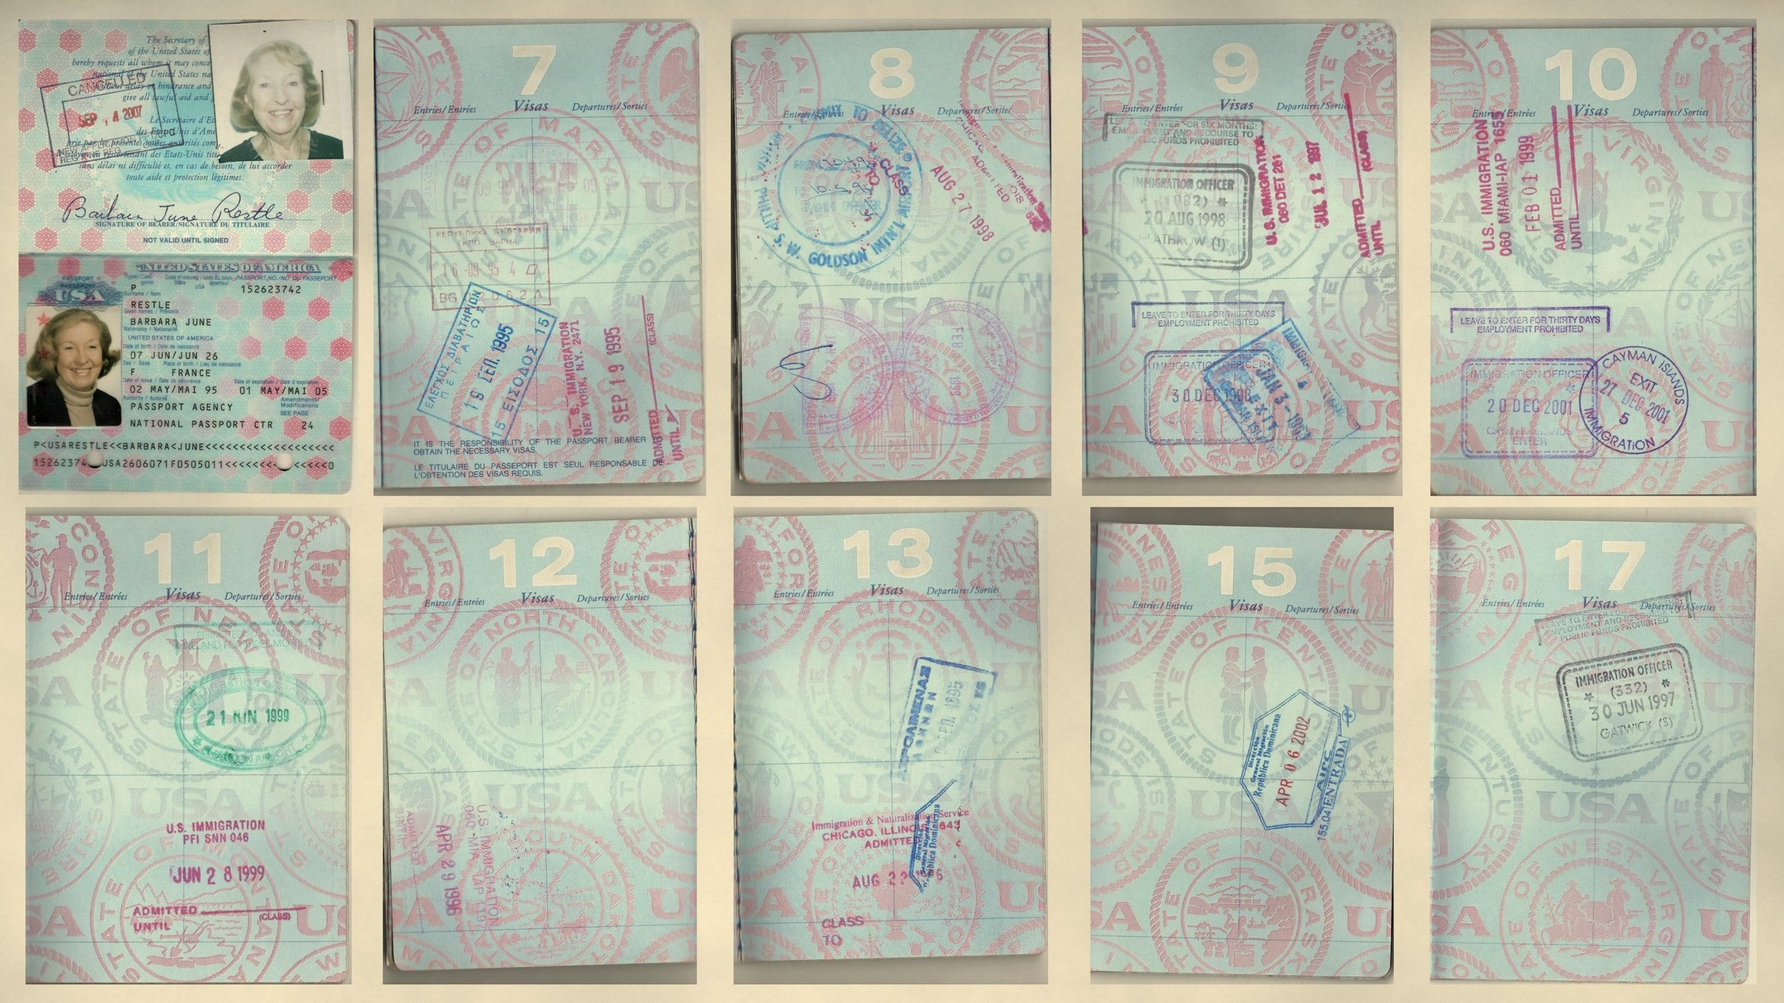
Her third passport, 1995–2007
Her third passport, issued in 1995 when she was nearly 69. Its stamps take her to Greece and Bulgaria, England, Belize, Ireland, the Cayman Islands and the Dominican Republic, the last in 2002, when she was 75.

Slide 17
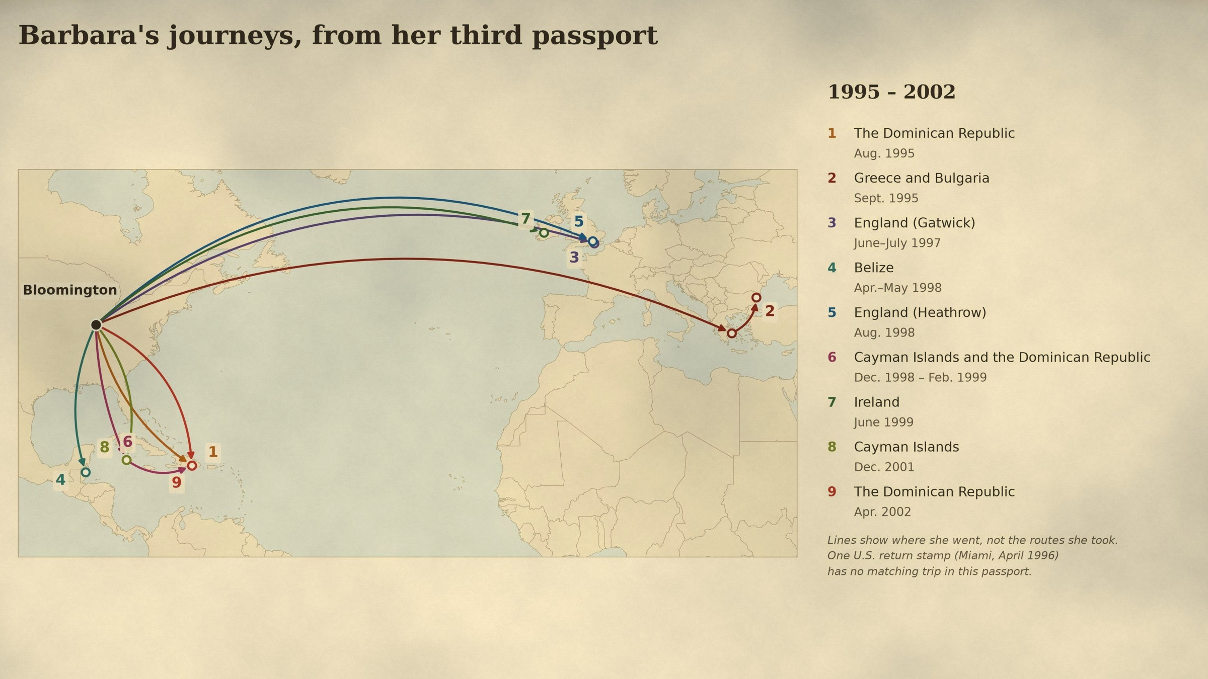
Map: her third passport journeys, 1995–2002
Where the third passport took her: the Aegean and the Black Sea, England and Ireland, and many trips to the Caribbean.

Slide 18
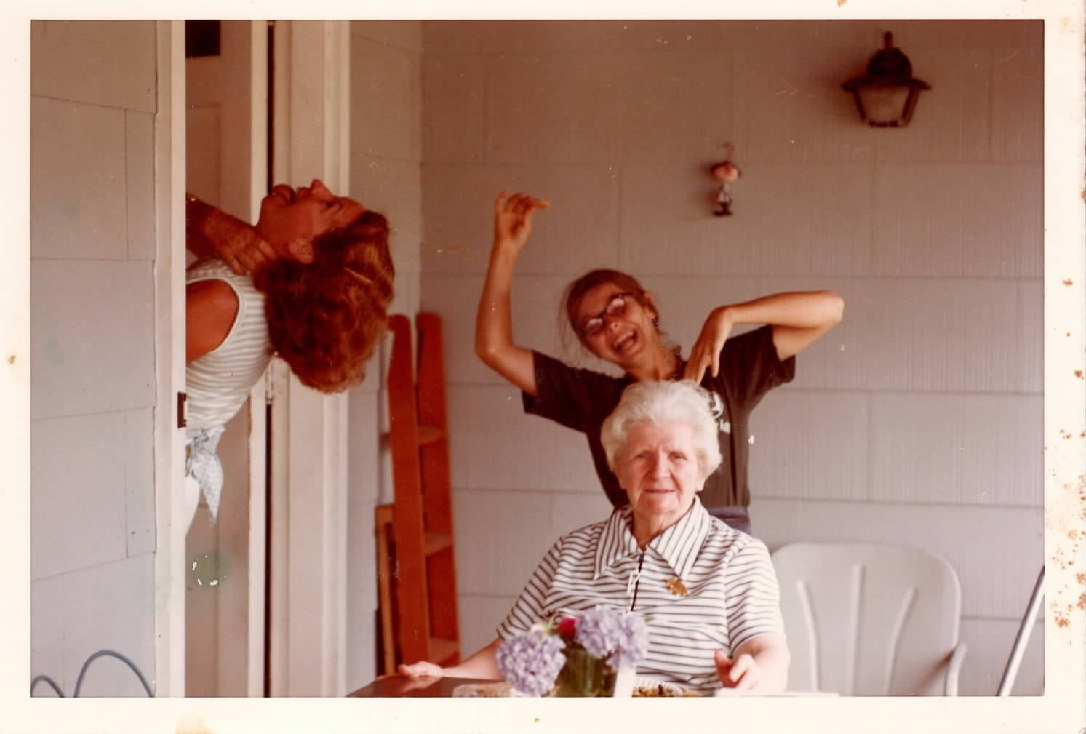
PART 4
Strangling …
Mom, never too serious for the camera.

Slide 19
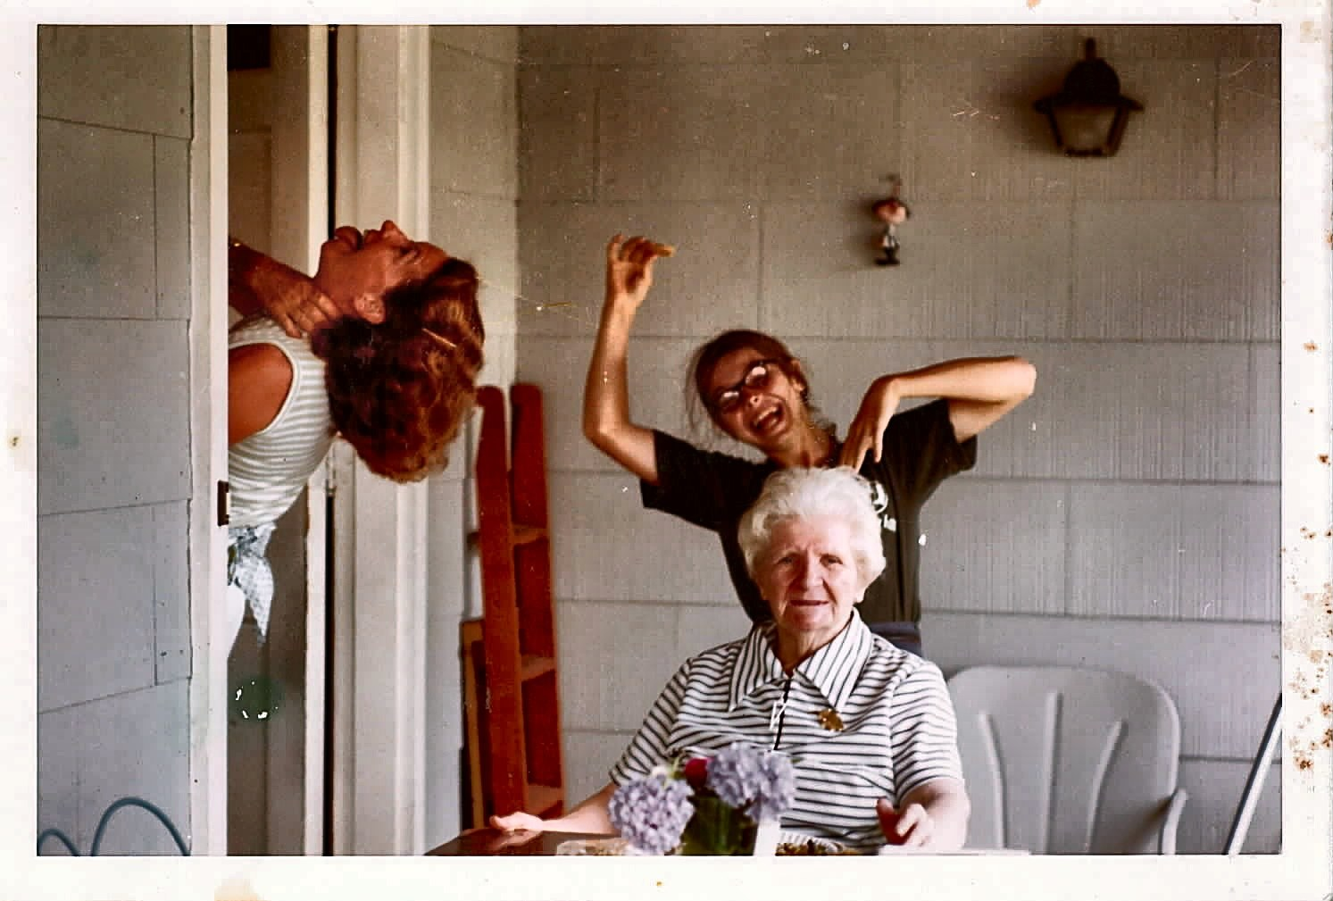
Metedeconk

Slide 20
